Slide 1



Making a Contextual Recommendation Engine using Python and Deep Learning
Muktabh Mayank Srivastava CoFounder
@muktabh
Muktabh-Mayank

Slide 2


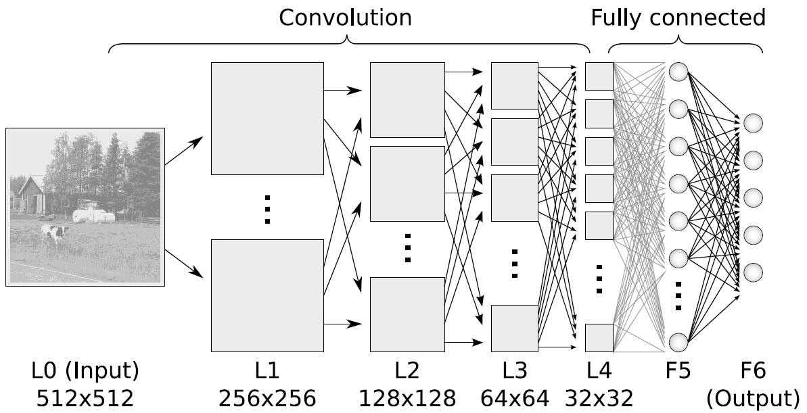
About ParallelDots
Machine Learning products company
Deep Learning as a Service APIs. Semantic Similarity, Entity Extraction, Autotagging, Sentiment Analysis.
Contextual Recommendation Engines for large publishers
Images taken from financialexpress.com and University of Bonn slides.

Slide 3
Why make recommendation engine ?
Solves problem of anomalous state of knowledge for the user.
Helps in content discovery.
Increases user engagement on website.
Helps monetize indirectly.
Pre-existing Solutions
CMS (say WordPress) provides a “Related Posts” plugin. This is TFIDF based search of article tags.
Fails many a times, Related Posts for all articles not visible.
Article tags often not contextual for SEO, produces garbage results many times.
Aims of new solution
Should be more accurate than TFIDF tag search.
Should be able to generate related posts for all articles.
Should be cheap to deploy. (Its still “related posts” at the end of it)

Slide 4
Why traditional methods wont work ?
Made our MVP with Latent Semantic Analysis.
Matrix Factorization methods like LSA were hard to scale on a vocabulary with size = ( vocab(English) + vocab(Indian Names)).
Switched to incremental LDA, but were not satisfied with accuracy.
So decided to try out representation learning. This minimizes hardware costs at deployment. Can use spot instances for training, which is still heavy, but a batch job and periodic.
Current Solution Overview
Generate low dimensional semantic document representations using Deep Neural Networks and heuristics.
Create a Space-Partitioning Tree of documents.
Refresh Trees at a higher frequency to add new documents.
Refresh Representation Learning algorithms at low frequency to avoid topic drift.

Slide 5
Basics of Deep Learning
Deep Learning is name given to multi layered Neural Networks.
Layer(s) of weight are stacked on top of each other separated by layers of activation functions. Activation functions bring non-linearity into the learning, else multiple layers of weights would be same as one layer.
They are trained by backpropogation of errors generally by Gradient Descent.

Slide 6
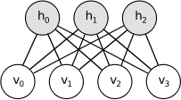
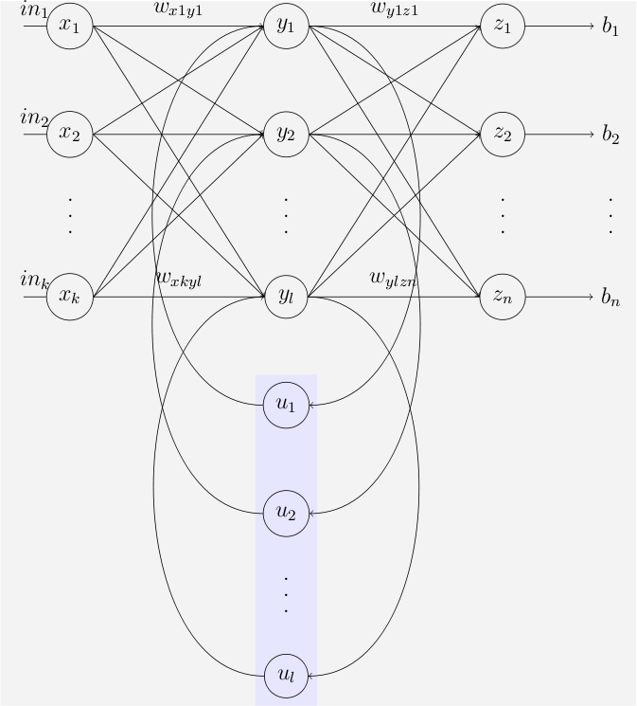
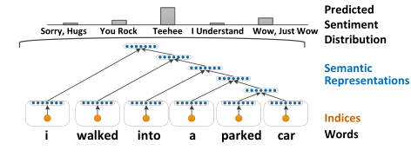
Popular Deep Neural Nets
Convolutional
Boltzmann Machines (RBMs more common)
Recurrent
Recursive
Images taken from wikipedia, Socher et al(2012), deeplearningtutorials.net and University of Bonn slides.

Slide 7
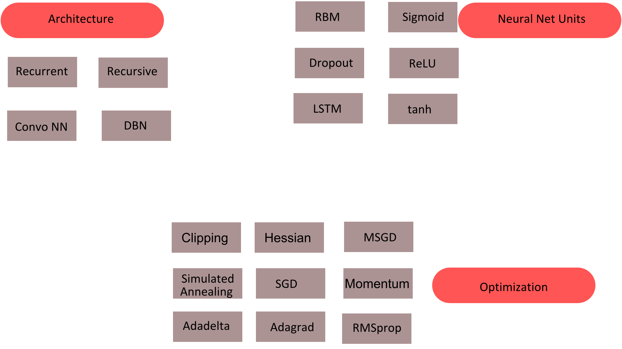
More Neural Network Vocab

Slide 8
Deep Learning for NLP
Basic Representation (Inputs to Neural Networks)
Bag of Words like
Word Embeddings
Dense Low dimensional Representation of each word as a “thought vector”
Are points in vector spaces corresponding to real world meanings, s.t., R(“king”) - R(“Man”) ~ R(“Queen”)
Two approaches: predicting next word given last n words (Word2Vec) or based on Co-occurrence Matrix (Glove). Both seem to be theoretically related.
New approach: Use Autoencoder to predict co-occurrence matrix: https://github.com/ParallelDots/WordEmbeddingAutoencoder
Character Level
Character Level
Newest (and possibly coolest) Trend. Already writing music and poetry. Based on a 2011 paper.
http://karpathy.github.io/2015/05/21/rnn-effectiveness/

Slide 9
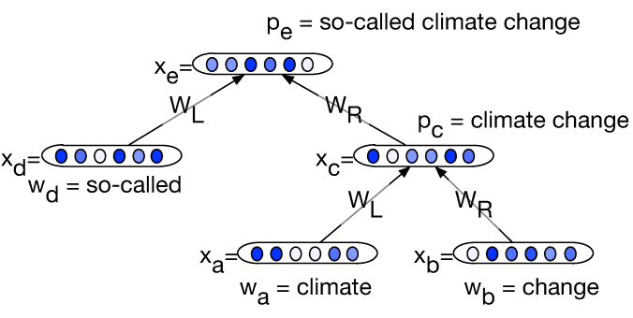
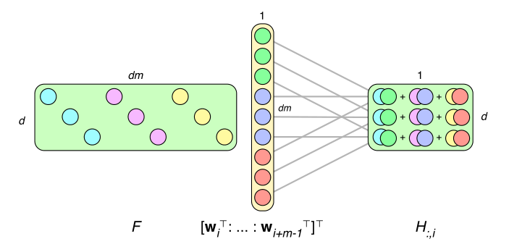
Models we use at ParallelDots
In Search Engine
Recursive Neural Networks to combine Word Vectors into phrase Vectors for semantic closeness.
Heuristically combining Word/Phrase Vectors for similar entity based near neighbors.
Recursive Neural Networks to combine Word Vectors into phrase Vectors for semantic closeness.
Heuristically combining Word/Phrase Vectors for similar entity based near neighbors.
Recursive Neural Networks to combine Word Vectors into phrase Vectors for semantic closeness.
Heuristically combining Word/Phrase Vectors for similar entity based near neighbors.
Recursive Neural Networks to combine Word Vectors into phrase Vectors for semantic closeness.
Heuristically combining Word/Phrase Vectors for similar entity based near neighbors.
Others
Convolutional Neural Networks to capture Sentiments in text.
Recursive Neural Net based entity extraction.
Images taken from sclweb and University of Oxford ACL tutorial slides.

Slide 10



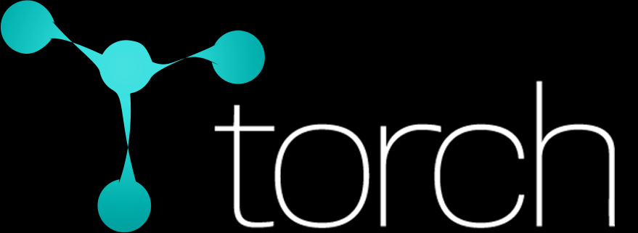

Implementing Models
Production Workhorse @ ParallelDots
Light CPU tryouts

Slide 11
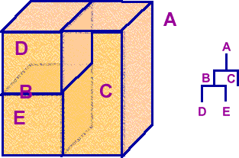
Searching for Similar Documents
Arrange Document Representation on a Space partitioning Tree.
Uses VPTree because of minimal requirements.
Makes query O(log n)< querytime < O(N).
Fast implementation in Numpy.
Right now documents divided into buckets and hosted one bucket/core using Python's multiprocessing.
Future Work: Shared memory model to make it work as true O(log(n)).

Slide 12

Handling News Website Traffic
We thought that we could just put Redis with Python during MVP, cache recommendations and serve. It did not work out.
The most similar physical phenomenon to News Traffic is an Earthquake. One might have 1000s of concurrent users on a webpage in a second as soon it is shared on Social Media. This puts insane load on server before results are cached.
We now use Golang channels to group these requests and deduplicate hits on Machine Learning infrastructure. Redis is used for caching. Handles upto 3000 concurrent users on a single box.

Slide 13
Thank You :) .
Please try our demo at ParallelDots.com

